Slide 1
CARBON MANAGEMENT FOR PORT AND NAVIGATION INFRASTRUCTURE
PIANC Work Group (WG) 188
Working Group Member: Lisa Wunder
Port of Los Angeles
AAPA Environment Committee Meeting
April 27, 2017
Long Beach, California
Notes:
Note that WG188 started about a year ago February so we are about mid-point in our efforts at developing a guidance document.

Slide 2
AGENDA
Background
WG188 objectives and activities to date
Scope and content of WG188 guidance document
Example case studies

Slide 3
BACKGROUND
COP21 – national commitments to reduce Greenhouse Gas (GHG)/carbon emissions
International Maritime Organization (IMO) – shipping GHG emissions
PIANC/Think Climate Coalition formed to address GHG mitigation and climate change adaptation in the navigation sector.
Notes:
Paris Agreement commits nations to GHG reductions to keep global temperature rise below 2C (target of 1.5C).
Global shipping in international waters was not included in the agreement
There is debate on whether shipping emissions in national waters are included but it is clear that the navigation infrastructure emissions would fall within the national commitments to reduce GHGs
This is the backdrop for activities in the navigation sector
Including IMO working on global shipping emissions
And why PIANC and its coalition partners formed the Think Climate coalition as all parts of societies – including the logistics/navigation sectors will need to do their part to help achieve the GHG emission reductions needed to meet the global goal.

Slide 4
WHY MANAGE CARBON IN NAVIGATION SECTOR?
1) Comply with emerging GHG regulatory requirements.
2) General stakeholder/public pressure to reduce environmental burdens.
3) Leadership role in carbon management practices.
4) Drive innovation and investment while influencing future practice and regulation.
5) Take advantage of unique opportunities to reduce and offset emissions from waterways navigation infrastructure development.
Notes:
So why should this sector manage carbon?
5 basic reasons from the WGs perspective
First is just basic compliance with current/future regulations
Second is related to the social contract for operating
Third and fourth are more aspirational objectives and match PIANC’s motto of “setting the course”
Fifth is most intriguing for navigation infrastructure given their unique opportunities to sequester carbon in ecosystems that may be restored as part of a project.
Given these very good reasons – PIANC setup WG188 to tackle the task to develop guidance to manage carbon in the navigation sector

Slide 5
WG188 CHARGE
Review and report on the technical literature related to the carbon footprint of navigation infrastructure and supporting activities.
Provide guidance on applying life cycle analysis and related assessment tools and techniques.
Investigate opportunities for reducing atmospheric GHGs:
  operational practices
  Working with Nature
  land use management
  blue carbon projects
  related environmental management
Notes:
So what did PIANC charge us to do?
Take a look at what is already out there on carbon footprinting that would be relevant to the navigation sector
Consider life cycle analysis
Third item includes aspects related to sequestration of carbon like WWN and blue carbon projects

Slide 6
WG 188 ACTIVITIES TO DATE
Joint PIANC/IAPH Work Group
WG188 Governance
  WG Chair: Doug Daugherty (US Section)
  WG Secretary: Talmor Meir (US Section YP)
  Mentor from PIANC: Filip Vandeputte (Belgium Section)
Established membership spanning the EU, USA, and Asia/Pacific
Developed guidance document outline
Currently developing text: final report anticipated mid-2018
Notes:
We only got started about 1 –year ago and since then we have
Set up our governance and established membership with members in EU, US, and Asia/Pacific
We established our scope and developed an extended outline for our eventual guidance document
Currently developing text and have an initial rough draft
We anticipate our report would come out in mid-2018

Slide 7
Key Carbon Management References Identified
Framework Guidance
Management Standard
Emissions Quantification
Notes:
We did identify some framework guidance and management standard on carbon management for general infrastructure (bridges, roads, etc).
These will be helpful but the lack a focus on the unique nature of and opportunities for the navigation sector and our WG job will be to add that perspective.
We did identify references for emission quantification as well as for carbon sequestration
Our objective is not to create or duplicate quantification methods already available
We will signpost to these methods and describe pros/cons as part of the WG’s work

Slide 8
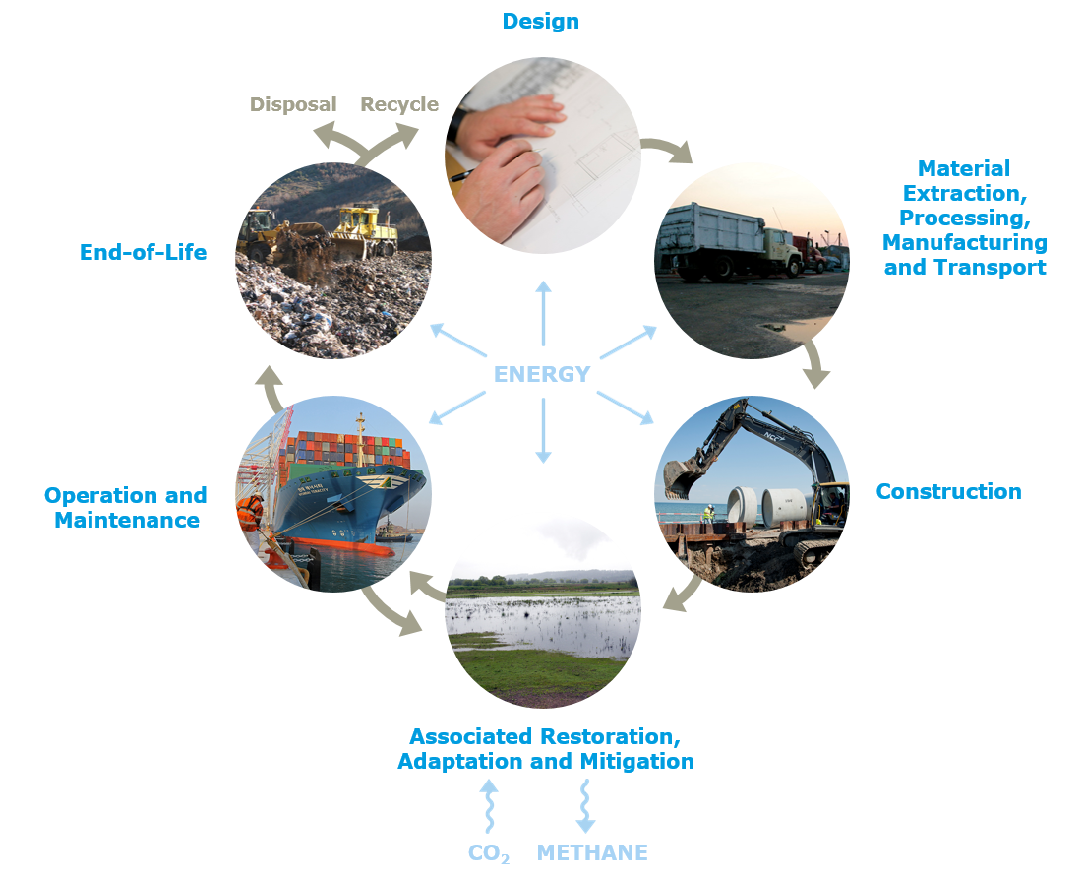
Carbon management life cycle for navigation infrastructure and Projects
Notes:
An important milestone for the work group was establishing that we would look at the entire lifecycle for navigation infrastructure
Design – where you can have the greatest control over the eventual life-time carbon footprint of the infrastructure even though it directly will contribute small amounts of GHGs
Materials used and the embodied carbon from their manufacture and transportation to the site
Using the materials to construct the infrastructure as well as any associated restorations, adaptations and mitigations.
This is the opportunity for the navigation infrastructure to sequester carbon that could be used to offset GHG emissions elsewhere in the cycle. These can include working with nature adaptations to climate change.
Includes operations and maintenance (like dredging) for the infrastructure. This is where you could also include third-party emissions using the infrastructure – something you may want to consider if you design your project to improve operational efficiency then you may want to take credit for that in your framework, by way of one example.
Finally is end of life considerations. Decisions make in design can make it easier or harder to recycle the materials at this stage.

Slide 9
CONTENT OF GUIDANCE DOCUMENT
Carbon Management Framework
  Scope: whole life-cycle
  Boundaries (geographic and time)
  Stakeholder considerations
  Reporting and monitoring
Quantification Methods
  Emissions from energy consumption – all parts of life-cycle
  Carbon sequestration from restored ecosystems
Carbon reduction opportunities and co-benefits
Incorporation of financial decision making
Case studies
Notes:
The guidance document will not be prescriptive. It is meant to provide all the relevant considerations for management to decide when developing their carbon management framework.
- The bullets above describe what is currently envisioned in the guidance document.

Slide 10
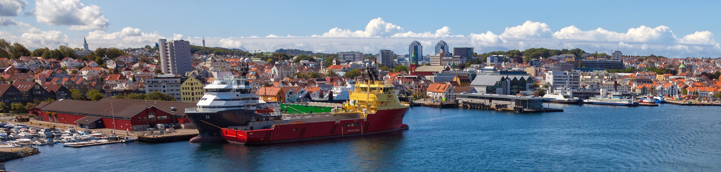
examples
Maritime carbon management

Slide 11
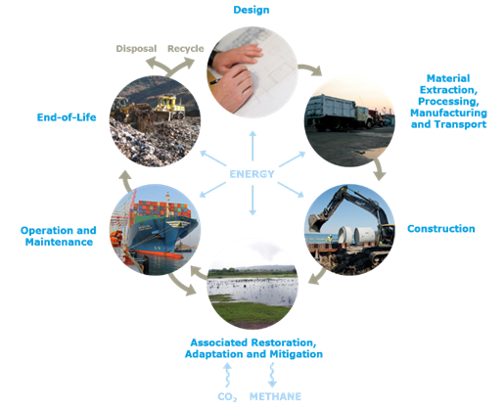
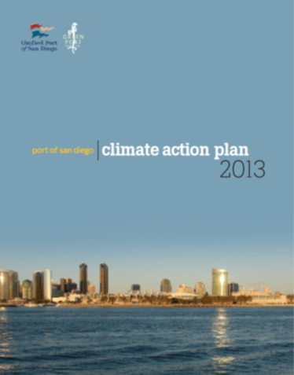
Objectives of the port of san Diego
Climate Action Plan
Designed to support
  A long-term vision and future success as a thriving, working port
  Port Master Plan and Strategic Plan
  The Green Port Policy
  State regulations designed to reduce GHG emissions
  Interagency interaction with other city/regional/agency entities
Framework to reduce future emissions
  New Projects: planning/design/environmental review process
  Existing Operations: implementation of identified policies
Notes:
This is a case study where the WG188 chair was involved as the lead consultant.
Port of San Diego develop a carbon reduction plan called “Climate Action Plan”.
It covers not just their emissions but also their tenant emissions within the geographic scope defined by the port.
It is designed to support various port programs/policies
The framework covers both existing operations and new projects
Thus is covers the three aspects of our carbon lifecycle for navigation infrastructure shown in upper right corner

Slide 12
Key elements of the climate action plan
Greenhouse Gas (GHG) Mitigation
Baseline/future projections (own and tenants)
Goals
Policies
Reduction Measures with co-benefits
Implementation
Notes:
Categories included energy, on-road vehicles, off-road vehicles, vessels, CHE, locomotives, water use, and waste
Goal is 10% below baseline year (2006) by 2020
Included discussion of co-benefits (talk about that on next slide)

Slide 13
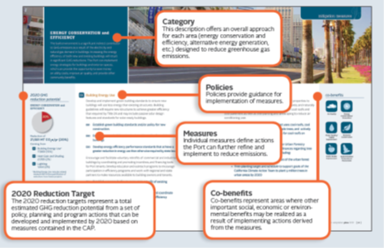
2020 GHG Emission reduction target categories
Transportation and Lane Use
(57%)
Energy Conservation and Efficiency
(20%)
Water Conservation and Recycling
(<1%)
Alternative Energy Generation
(20%)
Waste Reduction and Recycling
(~3%)
Miscellaneous
(.03%)
Notes:
-Pie chart is breakdown showing that most reductions will come from transportation/land use, energy efficiency, and alternative energy.
The plan describes various policies and control measures to achieve the reductions.
It also discusses the co-benefits as some measures may improve AQ, public health, water quality, or other important benefits and the port wanted to capture these benefits that are beyond the GHG reduction potential of the measures.

Slide 14
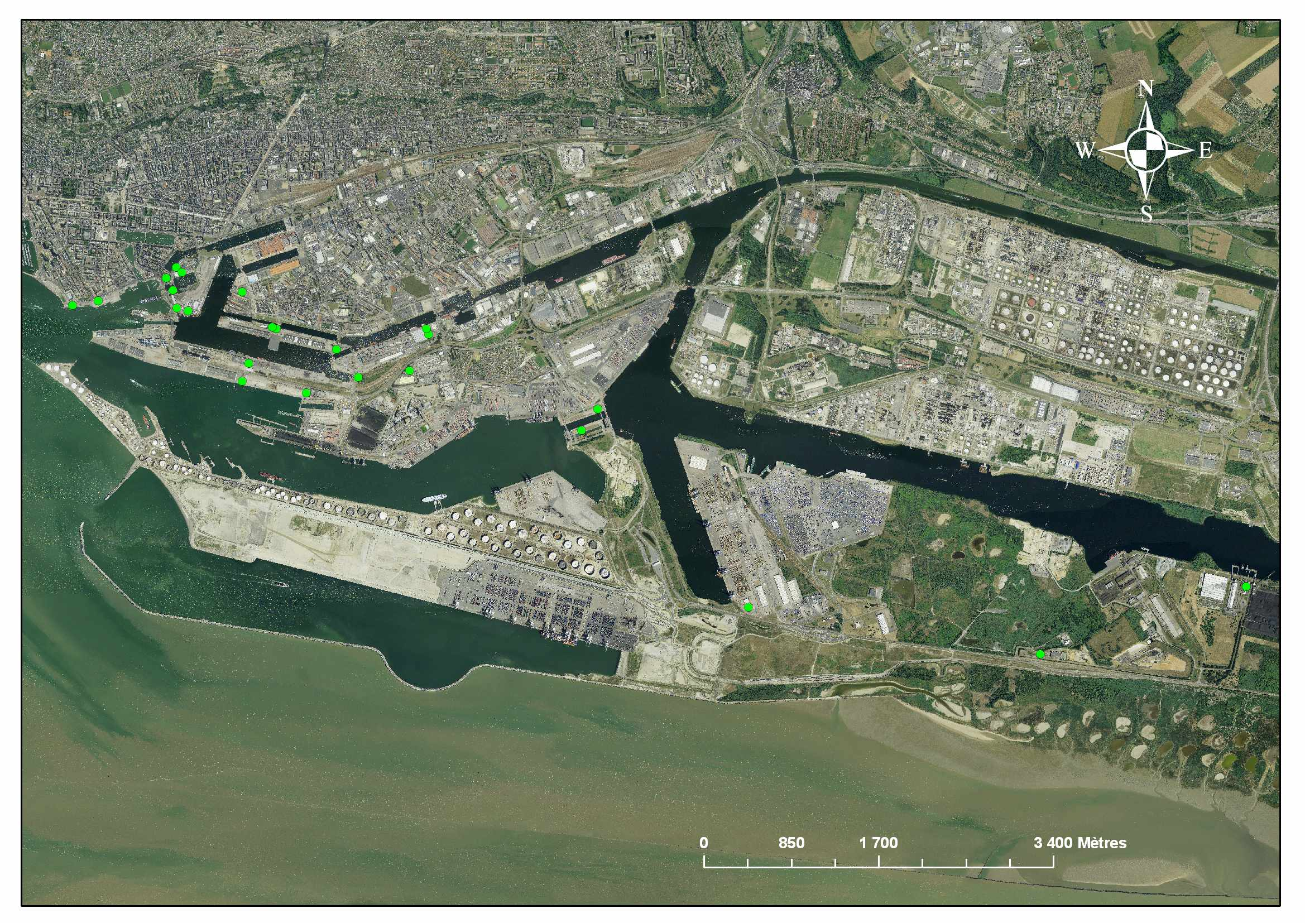

Le Havre port Authority
Regulatory ghg monitoring
Designed to comply with French law
  Carbon equivalent emissions
  Report on actions implemented to reduce emissions
Includes sources under direct financial control
  Direct energy and fuel
  Emissions from biomass (areas managed)
Includes indirect sources related to their operation
  Infrastructure energy use
  Waste
  Hired dredger emissions
Does not include tenants
Notes:
French law - article 75 of the law 2010-788 dated 12/07/2010
This example is from another member of WG188
It covers just sources under direct financial control of the port
It does report on emissions from biomass areas under their control so covers the operational and ecosystem portions of our lifecycle for navigation infrastructure as shown in upper right corner.
Does include their hired dredger emissions.

Slide 15
Case study – Dredged sediment placement
Strategies, Long Island Sound
Published Science of the Total Environment 511 (2015): 309-318
  US Army Corps of Engineers (Bates, Fox-Lent, Linkov)
  Massachusetts Institute of Technology (Seymour)
  Arizona State University (Wender)
Notes:
Last example is from our USACE WG members
Focused on sediment placement strategies, which included a containment island built for bird life
So mainly maintenance and restored ecosystems part of our lifecycle as shown in graphic in upper right corner
Published article

Slide 16
Case study – Dredged sediment placement
Strategies, Long Island Sound
Science of the Total Environment 511 (2015): 309-318
Notes:
The case study looked at multiple environmental factors for the three scenarios studied but we focus only on GHGs here.
They looked at 3 scenarios – open water placement, upland placement, and the containment island.
The upland and containment island are higher mainly due to the need for additional diesel powered equipment (like trucks) in those options.
However, the containment island example may not have optimized the design to minimize construction emissions. It also did not account for carbon sequestration, which would have lowered the middle light blue bar.
The paper does go into other environmental considerations for these options as decisions are typically made based on multiple criteria and not just a single criteria like GHGs.

Slide 17


A goal without a plan is just a wish.
Antoine de Saint-Exupéry
Carbon Management Plans will become more prevalent in the navigation sector
WG188 Guidance will include all parts of navigation infrastructure life-cycle
  Flexible to allow management decisions on scope
WG188 would like to obtain more relevant case studies
  Inland waterway examples a priority
Notes:
Hopefully we have convinced you that a plan is needed to achieve a goal of reducing carbon emissions for navigation infrastructure as the quote says
Takeway messages include the bulleted list.

